Slide 1



Noida Institute of Engineering and Technology, Greater Noida
Knowledge Representation & Expert System
Unit: 04
Knowledge representation
Course Details
(B Tech 3rd Sem)
Alka Singh
Assistant Professor
B.Tech AIML
Alka Singh ACSAI-301 AI Unit 04

Slide 2
Knowledge-Based Agent in Artificial intelligence
An intelligent agent needs knowledge about the real world for taking decisions and reasoning to act efficiently.
Knowledge-based system are those system who have the capability of maintaining an internal state of knowledge, reason over that knowledge, update their knowledge after observations and take actions. These agents can represent the world with some formal representation and act intelligently.
Knowledge-based agent are composed of two main parts:
  Knowledge-base and
  Inference system.
Alka Singh ACSAI-301 AI Unit 04

Slide 3
Continue…
A knowledge-based agent must be able to do the following:
An agent should be able to represent states, actions, etc.
An agent Should be able to incorporate new percepts
An agent can update the internal representation of the world
An agent can deduce the internal representation of the world
An agent can deduce appropriate actions.
Alka Singh ACSAI-301 AI Unit 04

Slide 4
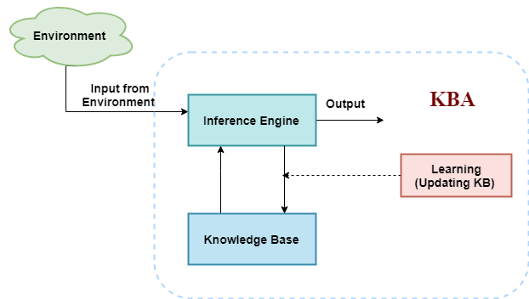
The architecture of knowledge-based agent
Alka Singh ACSAI-301 AI Unit 04

Slide 5
Continue…
The above diagram is representing a generalized architecture for a knowledge-based agent. The knowledge-based agent (KBA) take input from the environment by perceiving the environment. The input is taken by the inference engine of the agent and which also communicate with KB to decide as per the knowledge store in KB. The learning element of KBA regularly updates the KB by learning new knowledge.
Alka Singh ACSAI-301 AI Unit 04

Slide 6
Continue…
Knowledge base: Knowledge-base is a central component of a knowledge-based agent, it is also known as KB. It is a collection of sentences (here 'sentence' is a technical term and it is not identical to sentence in English). These sentences are expressed in a language which is called a knowledge representation language. The Knowledge-base of KBA stores fact about the world.
Why use a knowledge base?
Knowledge-base is required for updating knowledge for an agent to learn with experiences and take action as per the knowledge.
Alka Singh ACSAI-301 AI Unit 04

Slide 7
Operations Performed by KBA
Following are three operations which are performed by KBA in order to show the intelligent behaviour:
TELL: This operation tells the knowledge base what it perceives from the environment.
ASK: This operation asks the knowledge base what action it should perform.
Perform: It performs the selected action.
Alka Singh ACSAI-301 AI Unit 04

Slide 8
Various levels of knowledge-based agent
A knowledge-based agent can be viewed at different levels which are given below:
1. Knowledge level:
This is the basic and the most abstract level in a knowledge-based agent. This level describes the agent by what it knows, i.e. through its knowledge base. In this level, the information that the agent has, its goals and the utility are defined.
Example:
A house cleaning agent knows where the mop is and where the floor is and where the cleaning material like the soap and detergents are kept. All this is defined in the knowledge level.
Alka Singh ACSAI-301 AI Unit 04

Slide 9
Continue…
2. Logical level:
In the logical level, the raw and discrete information which is present in the knowledge level is encoded into sentences. In simple words, the agent in this level derives the logic out of the knowledge base according to the problem. It selects the required blocks of information and combines them meaningfully so as a decision could be made.
Example:
The house cleaning agent on getting all the information then checks and finds the place which is dirty and should be cleaned.
Alka Singh ACSAI-301 AI Unit 04

Slide 10
Continue…
3. Implementation level:
This is the final layer of the knowledge-based agent. In the implementation level, the logic which the agent has derived in the logical level is brought to implementation. This layer deals with the physical representation of the sentences.
Example:
The cleaning agent after finding the place to clean finally takes action and cleans the dirt on the floor and as a result, the agent gets clean floor which is the goal state that the agent is designed to achieve.
Alka Singh ACSAI-301 AI Unit 04

Slide 11
Approaches to designing a knowledge-based agent
There are mainly two approaches to build a knowledge-based agent:
Declarative approach: We can create a knowledge-based agent by initializing with an empty knowledge base and telling the agent all the sentences with which we want to start with. This approach is called Declarative approach.
Procedural approach: In the procedural approach, we directly encode desired behaviour as a program code. Which means we just need to write a program that already encodes the desired behaviour or agent.
However, in the real world, a successful agent can be built by combining both declarative and procedural approaches, and declarative knowledge can often be compiled into more efficient procedural code.
Alka Singh ACSAI-301 AI Unit 04

Slide 12
Rule-Based Systems
Rule-based systems or production systems are computer systems that use rules to provide recommendations or diagnoses, or to determine a course of action in a particular situation or to solve a particular problem.
A rule-based system consists of a number of components: a database of rules (also called a knowledge base), a database of facts, an interpreter, or inference engine
In a rule-based system, the knowledge base consists of a set of rules that represent the knowledge that the system has.
The database of facts represents inputs to the system that are used to derive conclusions, or to cause actions.
Alka Singh ACSAI-301 AI Unit 04

Slide 13
Rule-Based Systems
The interpreter, or inference engine, is the part of the system that controls the process of deriving conclusions. It uses the rules and facts, and combines them together to draw conclusions.
Using deduction to reach a conclusion from a set of antecedents is called forward chaining.
An alternative method, backward chaining, starts from a conclusion and tries to show it by following a logical path backward from the conclusion to a set of antecedents that are in the database of facts.
Alka Singh ACSAI-301 AI Unit 04

Slide 14
Forward Chaining and backward chaining in AI
In artificial intelligence, forward and backward chaining is one of the important topics, but before understanding forward and backward chaining lets first understand that from where these two terms came.
Inference engine:
The inference engine is the component of the intelligent system in artificial intelligence, which applies logical rules to the knowledge base to infer new information from known facts. The first inference engine was part of the expert system. Inference engine commonly proceeds in two modes, which are:
Forward chaining
Backward chaining
Alka Singh ACSAI-301 AI Unit 04

Slide 15
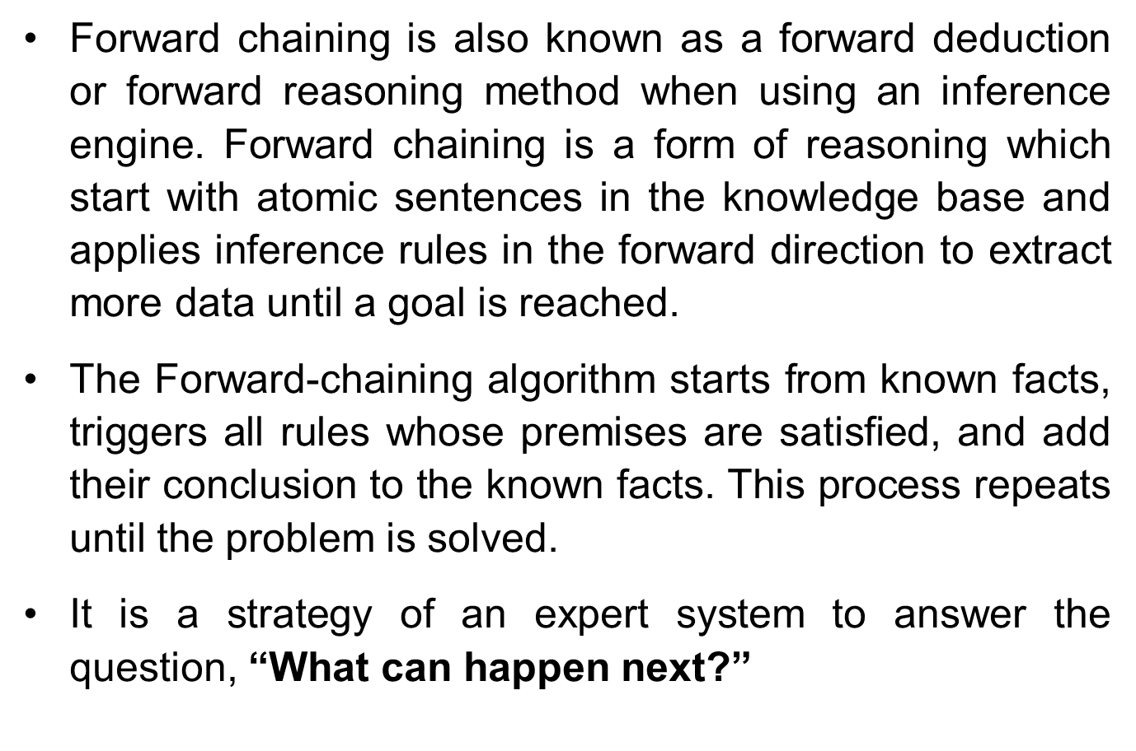
Forward Chaining
Alka Singh ACSAI-301 AI Unit 04

Slide 16
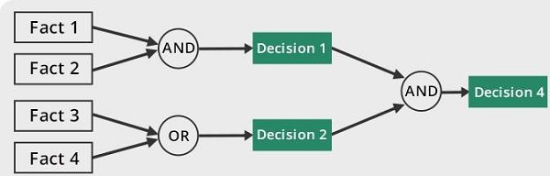
Forward Chaining
Alka Singh ACSAI-301 AI Unit 04

Slide 17
Forward Chaining
Properties of Forward-Chaining:
It is a down-up approach, as it moves from bottom to top.
It is a process of making a conclusion based on known facts or data, by starting from the initial state and reaches the goal state.
Forward-chaining approach is also called as data-driven as we reach to the goal using available data.
Forward -chaining approach is commonly used in the expert system, such as CLIPS, business, and production rule systems.
Alka Singh ACSAI-301 AI Unit 04

Slide 18
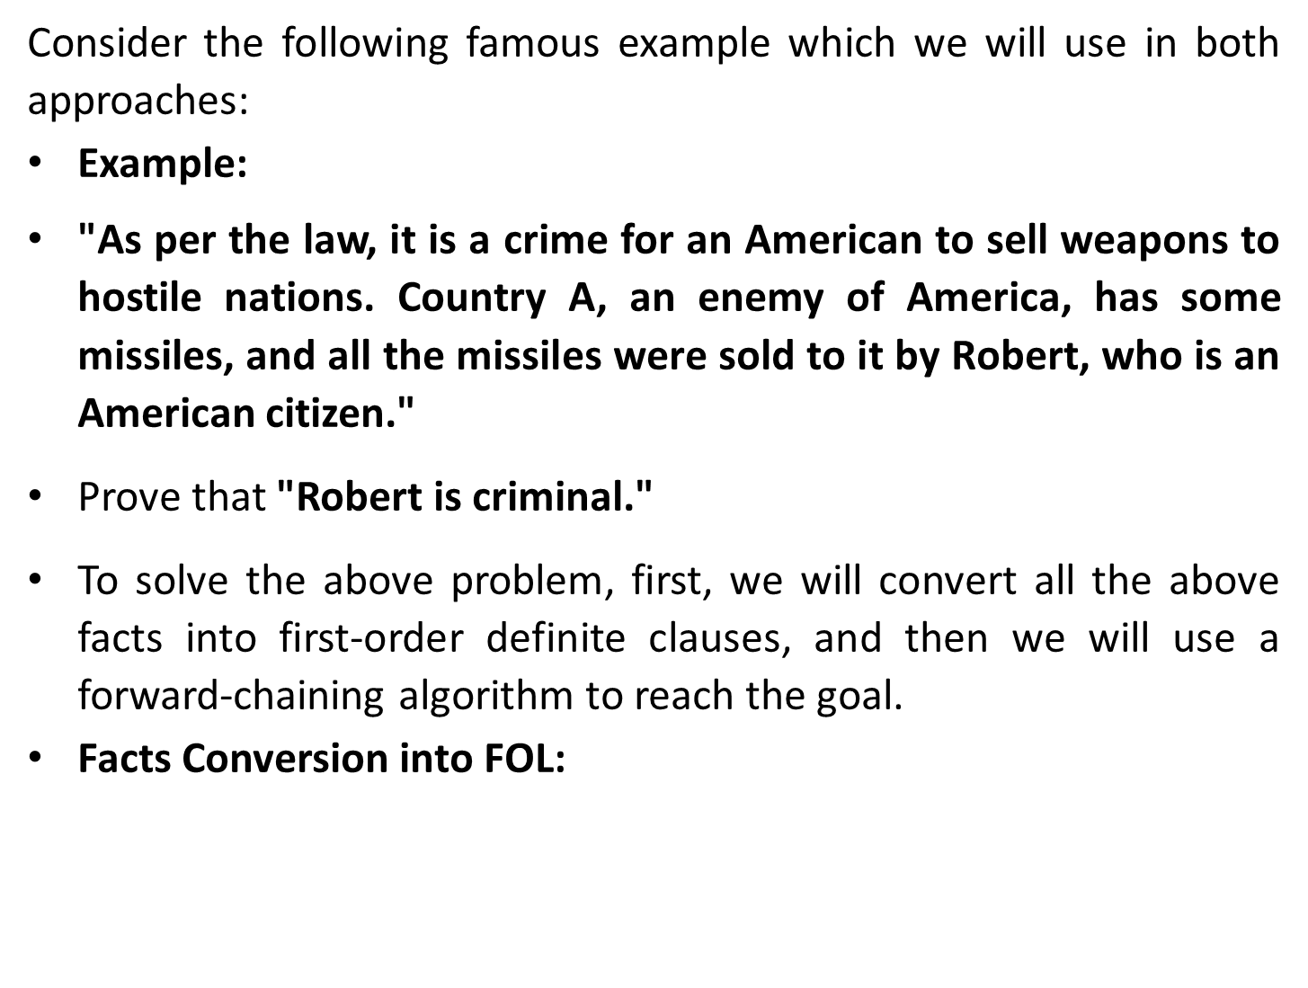
Alka Singh ACSAI-301 AI Unit 04

Slide 19
Continue…
It is a crime for an American to sell weapons to hostile nations. (Let's say p, q, and r are variables)
American (p) ∧ weapon(q) ∧ sells (p, q, r) ∧ hostile(r) → Criminal(p)
…………(1)
Country A has some missiles.
Ǝp Owns(A, p) ∧ Missile(p).
It can be written in two definite clauses by using Existential Instantiation, introducing new Constant T1.
Owns(A,T1) …………………..(2)
Missile(T1) …………………..(3)
All of the missiles were sold to country A by Robert.
∀p Missiles(p) ∧ Owns (A, p) → Sells (Robert, p, A) ………(4)
Alka Singh ACSAI-301 AI Unit 04

Slide 20
Continue…
Missiles are weapons.
Missile(p) → Weapons (p) ………………(5)
Enemy of America is known as hostile.
Enemy(p, America) → Hostile(p) …………(6)
Country A is an enemy of America.
Enemy (A, America) ………………(7)
Robert is American
American(Robert) ………………(8)
Alka Singh ACSAI-301 AI Unit 04

Slide 21
Continue…
Forward chaining proof:
Step-1:
In the first step we will start with the known facts and will choose the sentences which do not have implications, such as:
American(Robert), Enemy(A, America), Owns(A, T1), and
Missile(T1).
All these facts will be represented as below.
Alka Singh ACSAI-301 AI Unit 04

Slide 22
Continue…
Step-2:
At the second step, we will see those facts which infer from available facts and with satisfied premises.
Rule-(1) does not satisfy premises, so it will not be added in the first iteration.
Rule-(2) and (3) are already added.
Rule-(4) satisfy with the substitution {p/T1}, so Sells (Robert, T1, A) is added, which infers from the conjunction of Rule (2) and (3).
Rule-(6) is satisfied with the substitution(p/A), so Hostile(A) is added and which infers from Rule-(7).
Alka Singh ACSAI-301 AI Unit 04

Slide 23
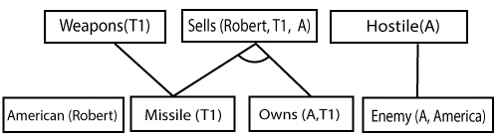
Continue…
Alka Singh ACSAI-301 AI Unit 04

Slide 24
Continue…
Step-3:
At step-3, as we can check Rule-(1) is satisfied with the substitution {p/Robert, q/T1, r/A}, so we can add Criminal(Robert) which infers all the available facts. And hence we reached our goal statement.
Alka Singh ACSAI-301 AI Unit 04

Slide 25
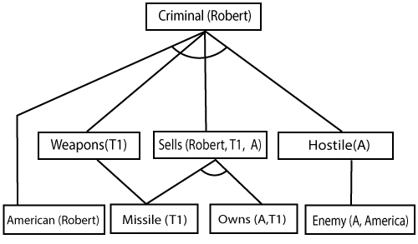
Continue…
Hence it is proved that Robert is Criminal using forward chaining approach.
Alka Singh ACSAI-301 AI Unit 04

Slide 26
Backward Chaining
Backward-chaining is also known as a backward deduction or backward reasoning method when using an inference engine. A backward chaining algorithm is a form of reasoning, which starts with the goal and works backward, chaining through rules to find known facts that support the goal.
With this strategy, an expert system finds out the answer to the question, “Why this happened?”
Properties of backward chaining:
It is known as a top-down approach.
Backward-chaining is based on modus ponens inference rule.
Alka Singh ACSAI-301 AI Unit 04

Slide 27
Backward Chaining
In backward chaining, the goal is broken into sub-goal or sub-goals to prove the facts true.
It is called a goal-driven approach, as a list of goals decides which rules are selected and used.
Backward-chaining algorithm is used in game theory, automated theorem proving tools, inference engines, proof assistants, and various AI applications.
The backward-chaining method mostly used a depth-first search strategy for proof.
Alka Singh ACSAI-301 AI Unit 04

Slide 28
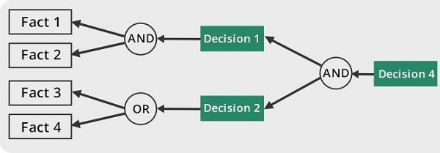
Backward Chaining
Alka Singh ACSAI-301 AI Unit 04

Slide 29
Example
Example:
In backward-chaining, we will use the same above example, and will rewrite all the rules.
American (p) ∧ weapon(q) ∧ sells (p, q, r) ∧ hostile(r) → Criminal(p) …….....(1)
Owns(A, T1) ..............(2)
Missile(T1) …………(3)
∀p Missiles(p) ∧ Owns (A, p) → Sells (Robert, p, A) …......(4)
Missile(p) → Weapons (p) ……….......(5)
Enemy(p, America) →Hostile(p) ……..........(6)
Enemy (A, America) ..…............(7)
American(Robert) ……...........(8)
Alka Singh ACSAI-301 AI Unit 04

Slide 30

Continue
Backward-Chaining Proof:
In Backward chaining, we will start with our goal predicate, which is Criminal(Robert), and then infer further rules.
Step-1:
At the first step, we will take the goal fact. And from the goal fact, we will infer other facts, and at last, we will prove those facts true. So, our goal fact is "Robert is Criminal," so following is the predicate of it.
Alka Singh ACSAI-301 AI Unit 04

Slide 31
Continue
Step-2:
At the second step, we will infer other facts form goal fact which satisfies the rules. So, as we can see in Rule-1, the goal predicate Criminal (Robert) is present with substitution {Robert/P}. So, we will add all the conjunctive facts below the first level and will replace p with Robert.
Alka Singh ACSAI-301 AI Unit 04

Slide 32
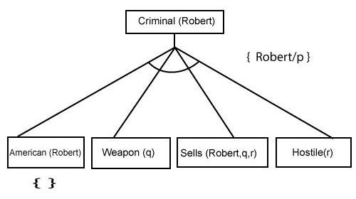
Continue
Here we can see American (Robert) is a fact, so it is proved here.
Alka Singh ACSAI-301 AI Unit 04

Slide 33
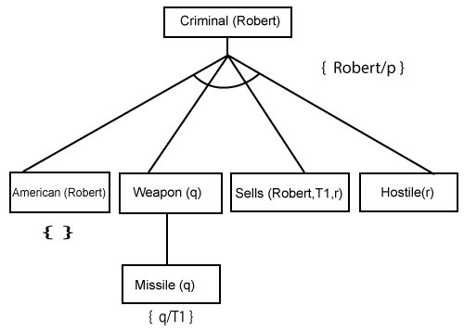
Continue
Step-3:
At step-3, we will extract further fact Missile(q) which infer from Weapon(q), as it satisfies Rule-(5). Weapon (q) is also true with the substitution of a constant T1 at q.

Slide 34
Continue
Step-4:
At step-4, we can infer facts Missile(T1) and Owns(A, T1) form Sells(Robert, T1, r) which satisfies the Rule- 4, with the substitution of A in place of r. So these two statements are proved here.

Slide 35
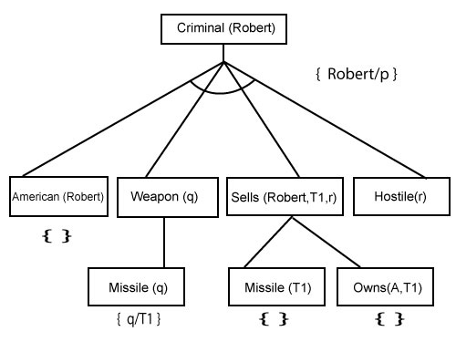
Continue

Slide 36
Continue
Step-5:
At step-5, we can infer the fact Enemy(A, America) from Hostile(A) which satisfies Rule- 6. And hence all the statements are proved true using backward chaining.
Alka Singh ACSAI-301 AI Unit 04

Slide 37
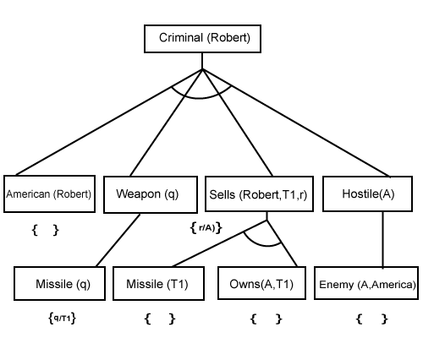
Continue
Alka Singh ACSAI-301 AI Unit 04

Slide 38
MCQ
Q1. Using how many levels can a knowledge-based agent be defined?
3 levels
2 levels
4 levels
None of the above
Ans A
Alka Singh ACSAI-301 AI Unit 04

Slide 39
MCQ
Q2. Which of the levels in a knowledge-based agent is the most abstract level?
Knowledge Level
Logical Level
Implementation Level
Can't be determined
Ans. A
Alka Singh ACSAI-301 AI Unit 04

Slide 40
MCQ
Q3. Which algorithm will work backward from the goal to solve a problem?
Forward chaining
Backward chaining
Hill-climb algorithm
None of the mentioned
Ans. B
Alka Singh ACSAI-301 AI Unit 04

Slide 41
MCQ
Q3. Which algorithm will work backward from the goal to solve a problem?
Forward chaining
Backward chaining
Hill-climb algorithm
None of the mentioned
Ans. B
Alka Singh ACSAI-301 AI Unit 04

Slide 42
MCQ
Q4. Which is mainly used for automated reasoning?
Backward chaining
Forward chaining
Logic programming
Parallel programming
Ans. C
Alka Singh ACSAI-301 AI Unit 04

Slide 43
MCQ
Q5. Which problem can frequently occur in backward chaining algorithm?
Repeated states
Incompleteness
Complexity
Both Repeated states & Incompleteness
Ans. D
Alka Singh ACSAI-301 AI Unit 04

Slide 44
MCQ
Q6. Which algorithm are in more similar to backward chaining algorithm?
Depth-first search algorithm
Breadth-first search algorithm
Hill-climbing search algorithm
All of the mentioned
Ans. A
Alka Singh ACSAI-301 AI Unit 04

Slide 45
MCQ
Q7. Which condition is used to cease the growth of forward chaining?
Atomic sentences
Complex sentences
No further inference
All of the mentioned
Ans. C
Alka Singh ACSAI-301 AI Unit 04

Slide 46
MCQ
Q8. How to eliminate the redundant rule matching attempts in the forward chaining?
Decremental forward chaining
Incremental forward chaining
Data complexity
None of the mentioned
Ans. B
Alka Singh ACSAI-301 AI Unit 04

Slide 47
MCQ
Q9. How many possible sources are there in forward chaining?
1
2
3
4
Ans. C
Alka Singh ACSAI-301 AI Unit 04

Slide 48
MCQ
Q9. Forward chaining systems are ________ where as backward chaining systems are ___________
Goal-driven, goal-driven
Goal-driven, data-driven
Data-driven, goal-driven
Data-driven, data-driven
Ans. C
Alka Singh ACSAI-301 AI Unit 04

Slide 49
Assignment
What are the applications of Knowledge Based System Design?
What are the various Knowledge Representation Schemes?
Explain Forward Chaining and Backward Chaining with diagram.
Elaborate architecture of Knowledge Based Systems.
Explain concept of Frames using Example.
Explain rule based system with respect to Expert System.
Explain Uncertainty management in Expert Systems.
What do you mean by Probabilistic Methods?
Define Knowledge Based Agent.
What are the parts of Knowledge Based Agent?
Draw and explain the architecture of Knowledge Based Agent.
Why there is need of probabilistic reasoning in AI?
Explain Forward Chaining and backward chaining in AI with example.
Bhawna Wadhwa ACSAI-301 AI Unit 01

Slide 50
Assignment
What are the two approaches to build a knowledge-based agent. Explain.
"A knowledge-based agent can be viewed at different levels",describe.
Explain Expert System with the help of Block Diagram.
Describe Architecture of Expert System in detail.
Write advantages and disadvantages of Expert system
Write down applications of Expert system.
Define Probabilistic Reasoning.
Define various types of knowledge.
Explain drawbacks in Semantic representation.
Explain the operations performed by Knowledge Based Agent in order to show the intelligent behaviour:
A knowledge-based agent can be viewed at different levels. Explain.
What are the advantages of using Frames?
Bhawna Wadhwa ACSAI-301 AI Unit 01

Slide 51
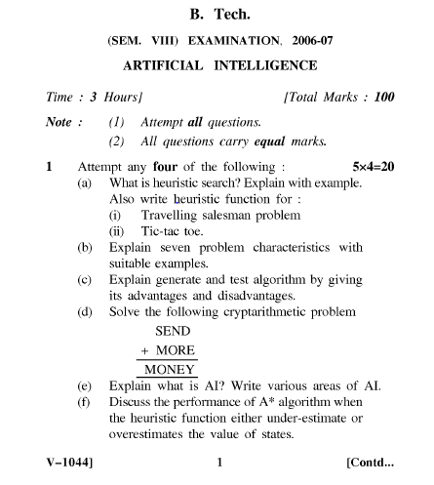
Old Question Papers
Bhawna Wadhwa ACSAI-301 AI Unit 01

Slide 52
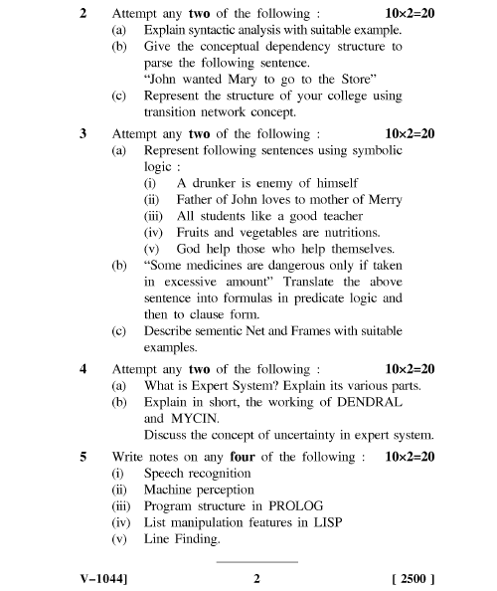
Old Question Papers
Bhawna Wadhwa ACSAI-301 AI Unit 01

Slide 53

Alka Singh ACSAI-301 AI Unit 04

